Slide 1
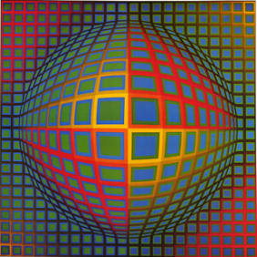
Op Art (Optical Art)
Vega-Nor
1969
By Vasarely

Slide 2
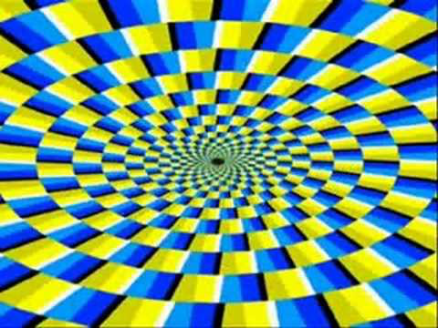
What is OP Art?
OP Art , also known as Optical Art, is a style of visual art that makes use of optical illusions of space and depth (plays tricks on the eyes).
Op Art works are abstract, with many of the better known pieces made in only in black and white. When the viewer looks at them, the impression is given of movement, hidden images, flashing and vibration, patterns, or alternatively, of swelling or warping.

Slide 3
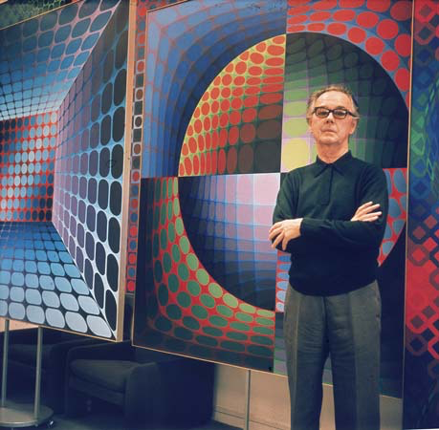
Victor Vasarely (pronounced Vas-er-rel-e)
Known as one of the originators of Optical Art “OP Art”
He was born in Hungary in 1906, but lived in France most of his life. He loved to paint using color and his favorite subjects were circles, squares and triangles.

Slide 4
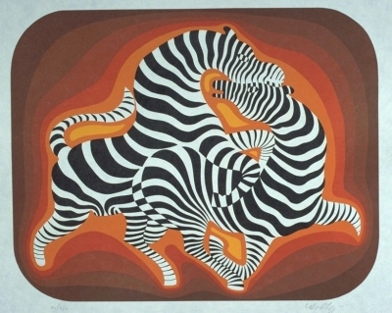
Vasarely’s Zebras
Painting titled Zebra was created in 1938 by Vasarely. This painting is said to have
started the Op Art Movement

Slide 5
Vasarely created over 800 sculptures and paintings in his lifetime.

Slide 6
Another artist that used Op Art was M.C. Escher
Relativity
1953

Slide 7
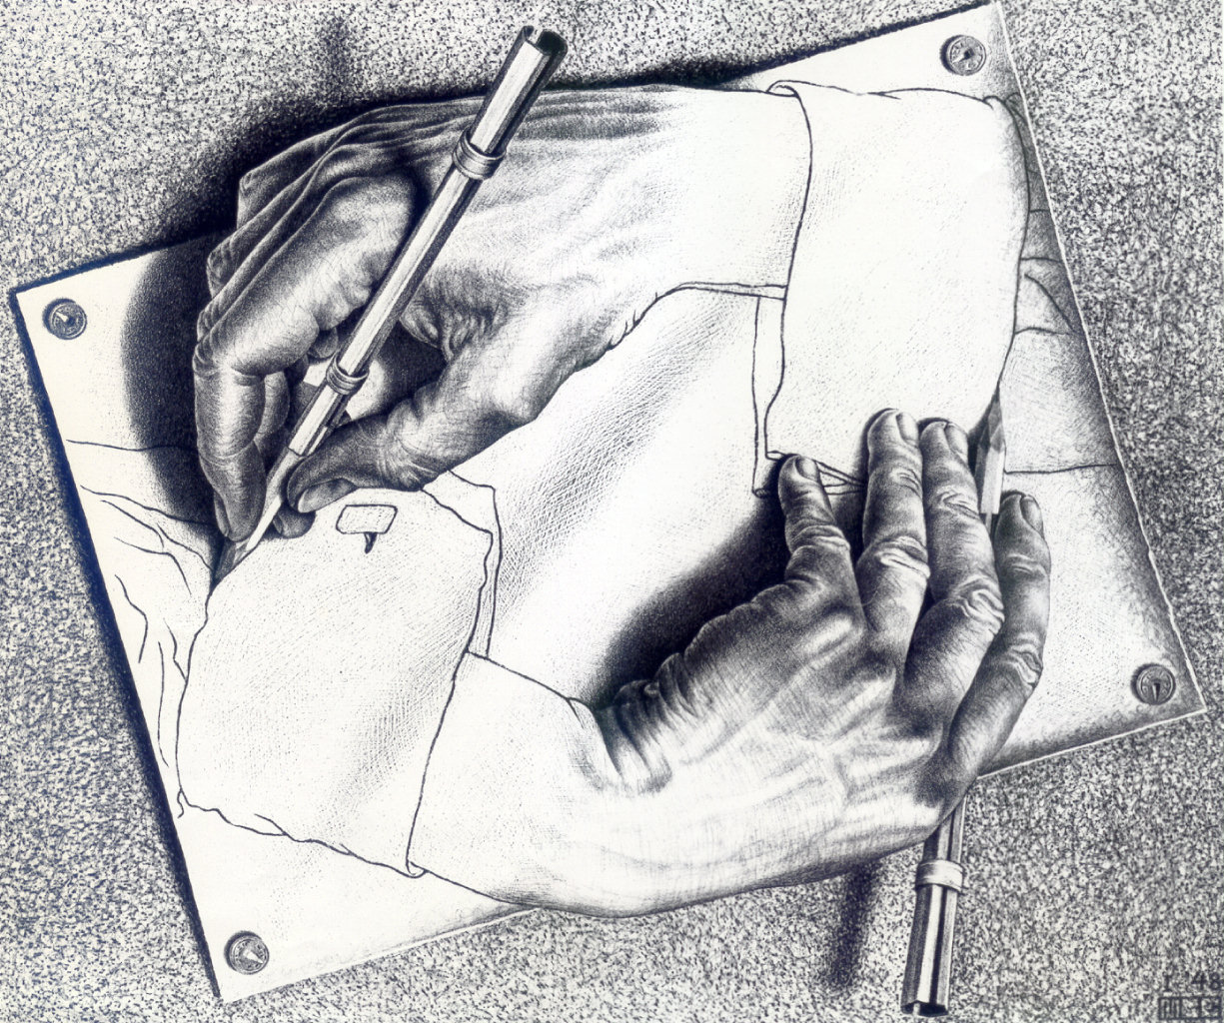
Another famous M.C. Escher work
Drawing Hands
1948
Notes:
this is a lithograph (printmaking)

Slide 8
Another Op Art Artist - Bridget Riley
Movement in Squares, 1961

Slide 9
Another Op Art work by Bridget Riley
Cataract 3
1967

Slide 10
How does Op Art relate to the Elements of Art you are studying as 4th graders?
We are using the element of art called form.
In art, form is a 3-dimensional object object that include length, width and depth. Forms and shapes can be geometric, organic or free form (as opposed to shape which is a two-dimensional object).
Fourth graders study how to create forms (ie. spheres, cones, cubes).
With today’s project you will be drawing implied cones to create the tunnel effect (creating the illusion of 3-dimensional objects rather than folding the paper in to a cones).
Elements of Art: The language of art or artistic “building blocks,” vocabulary, and visual symbols used to create works of art. These basic elements include: line, shape, form, texture, space, and color.

Slide 11
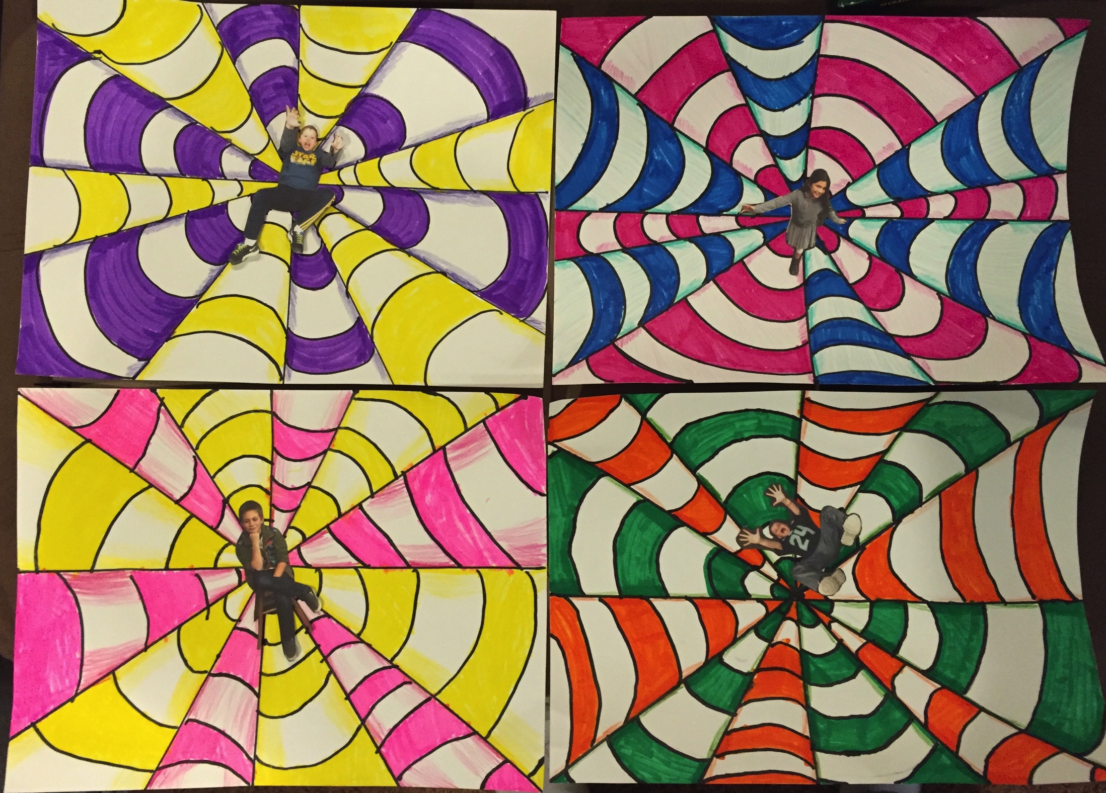
Today’s Project
Notes:
Supplies needed
Black sharpies (fine not ultra fine point)
Colored markers
Colored pencils
White paper (9x 12 tagboard)
Ruler
gluestick
Sample project
Photos of students
Scissors to cut out photos

Slide 12
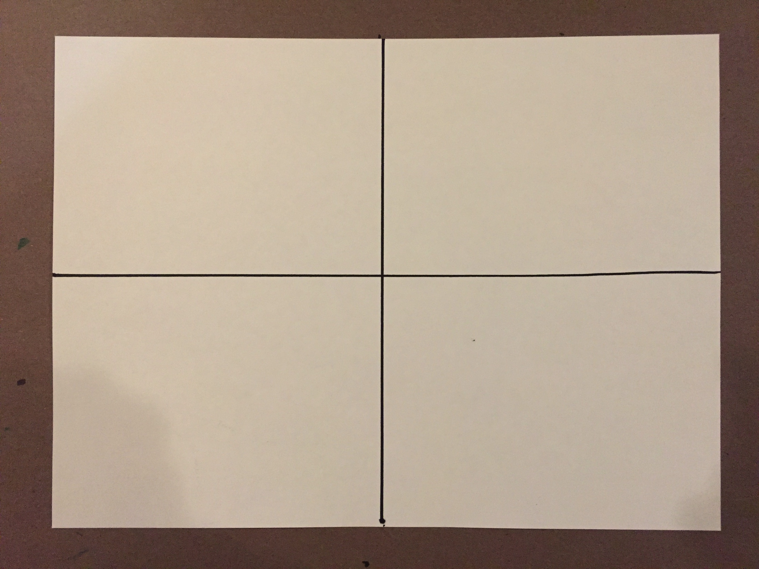
Step One – Draw a horizontal and vertical line about halfway on each side of the page with a sharpie.

Slide 13
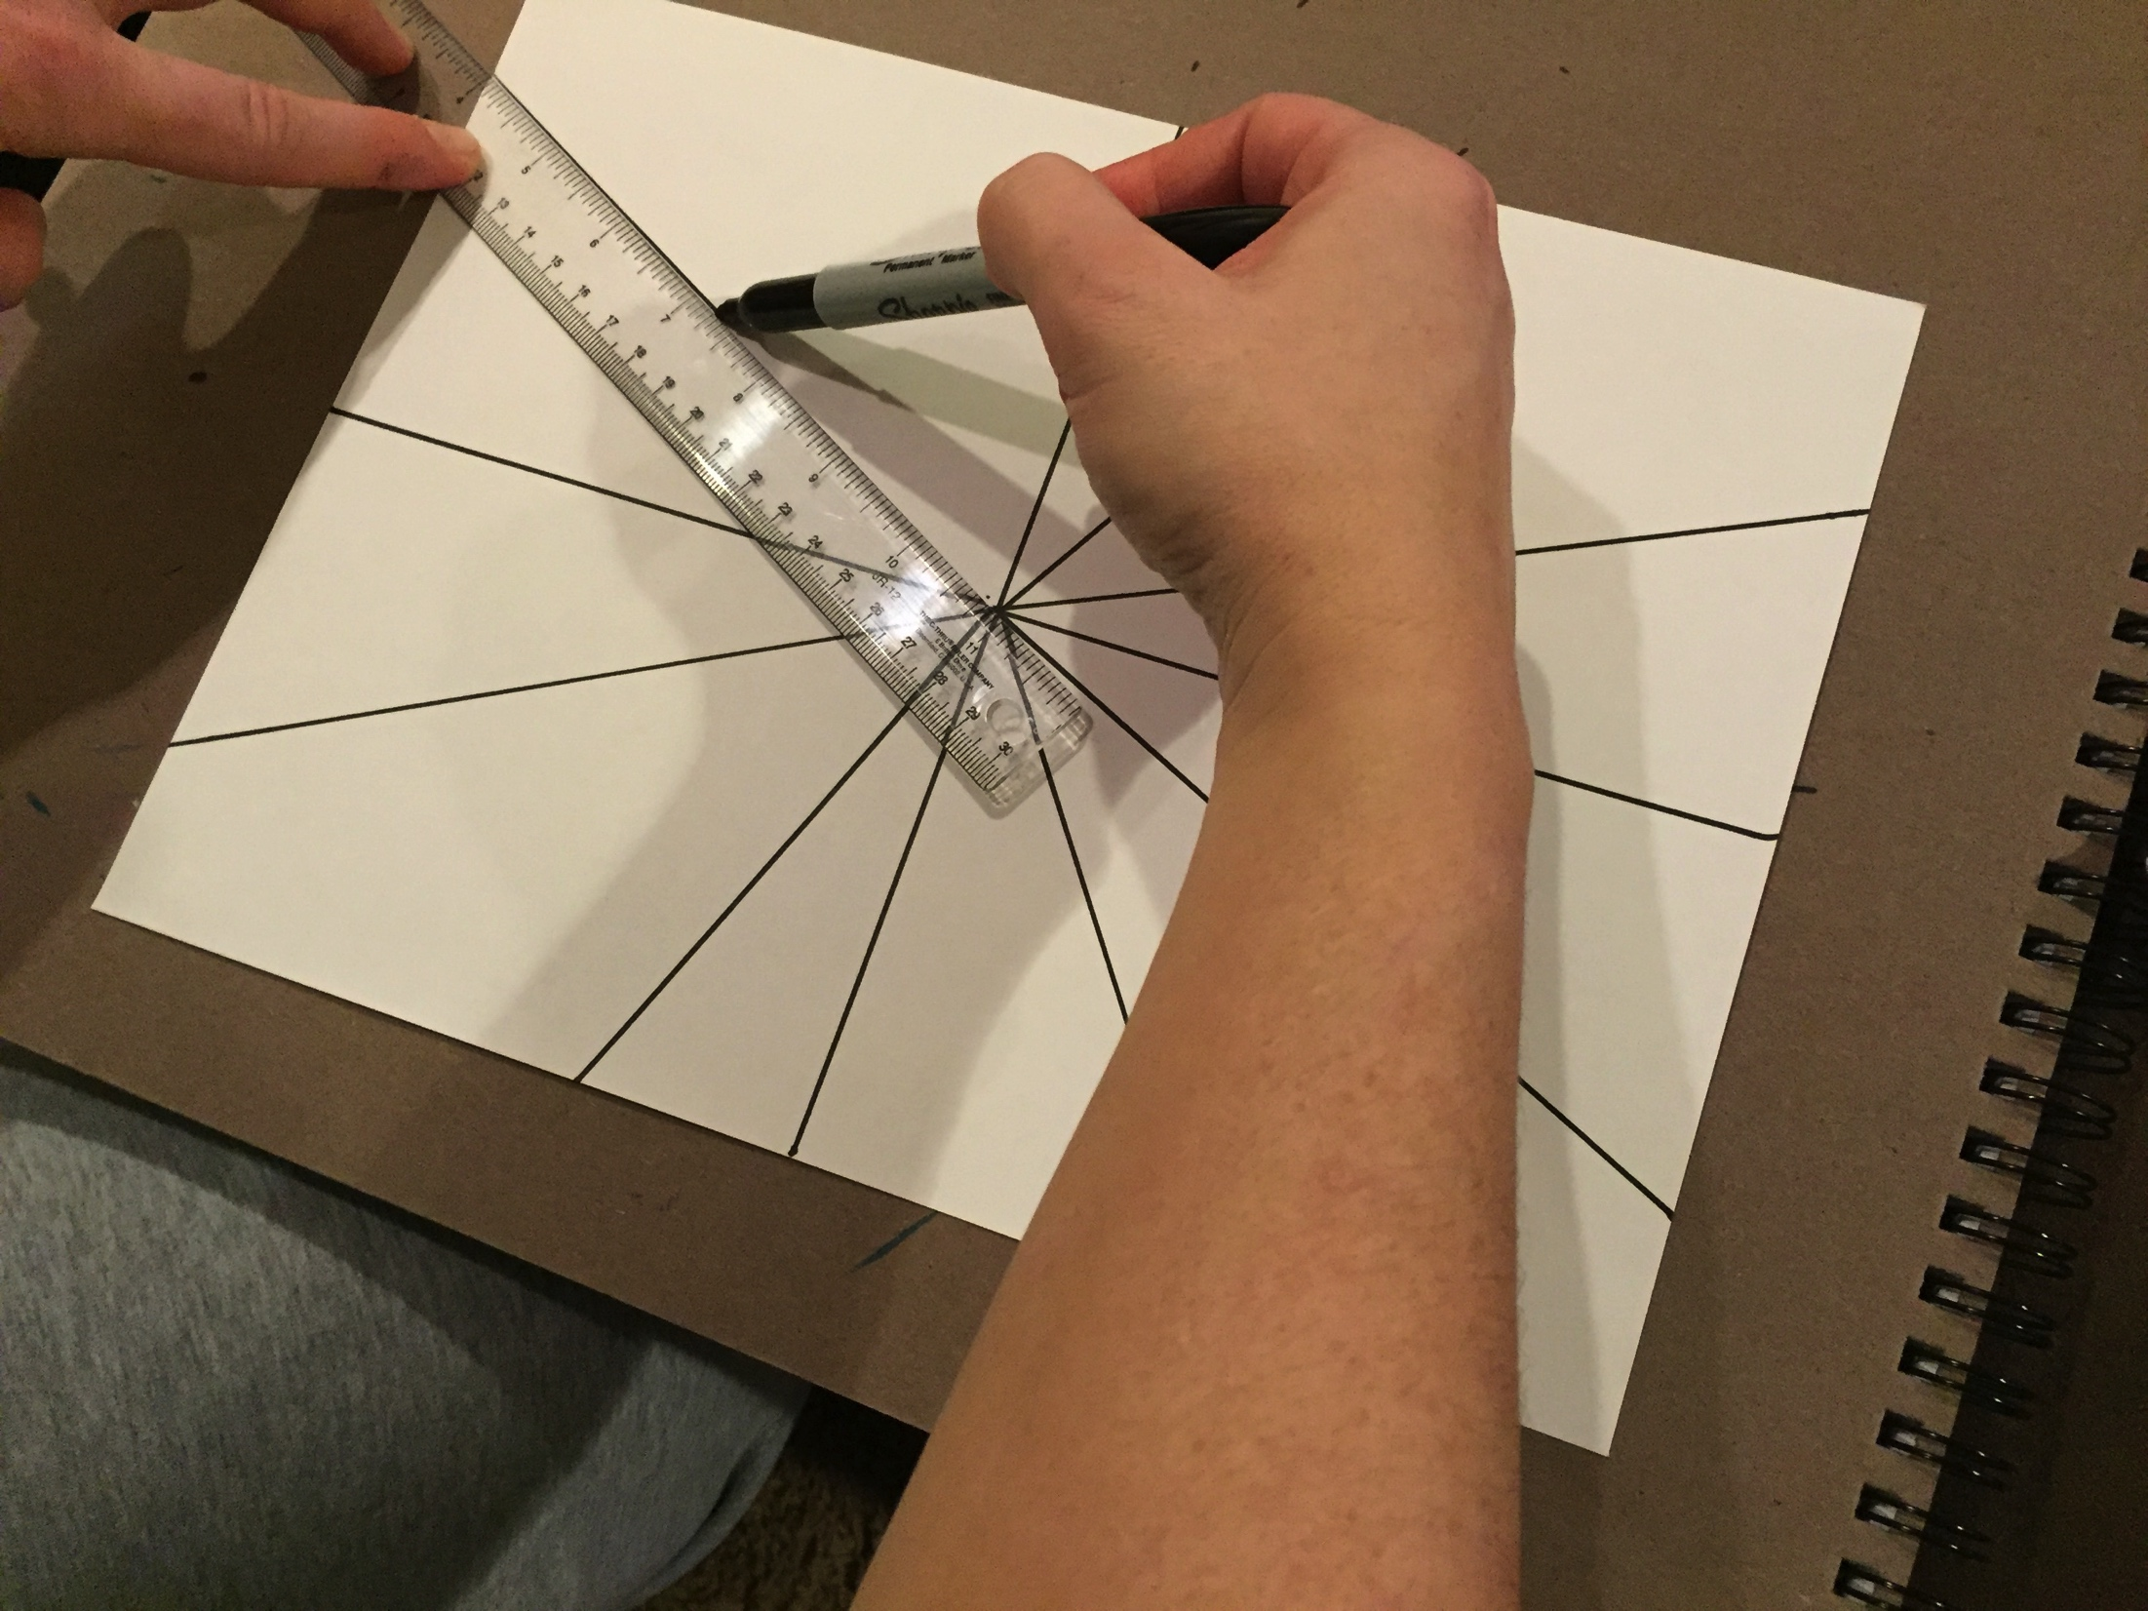
Step 2 – Draw two diagonal lines in each quadrant so that all lines connect in the center to create 12 triangles that will become 3-D cones.

Slide 14
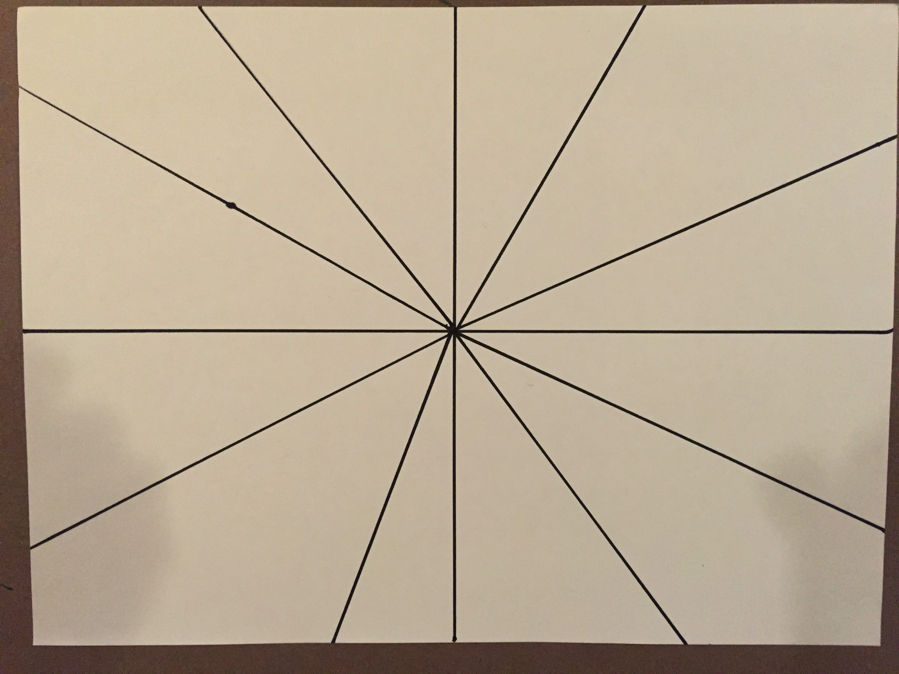
It should now look like this.

Slide 15
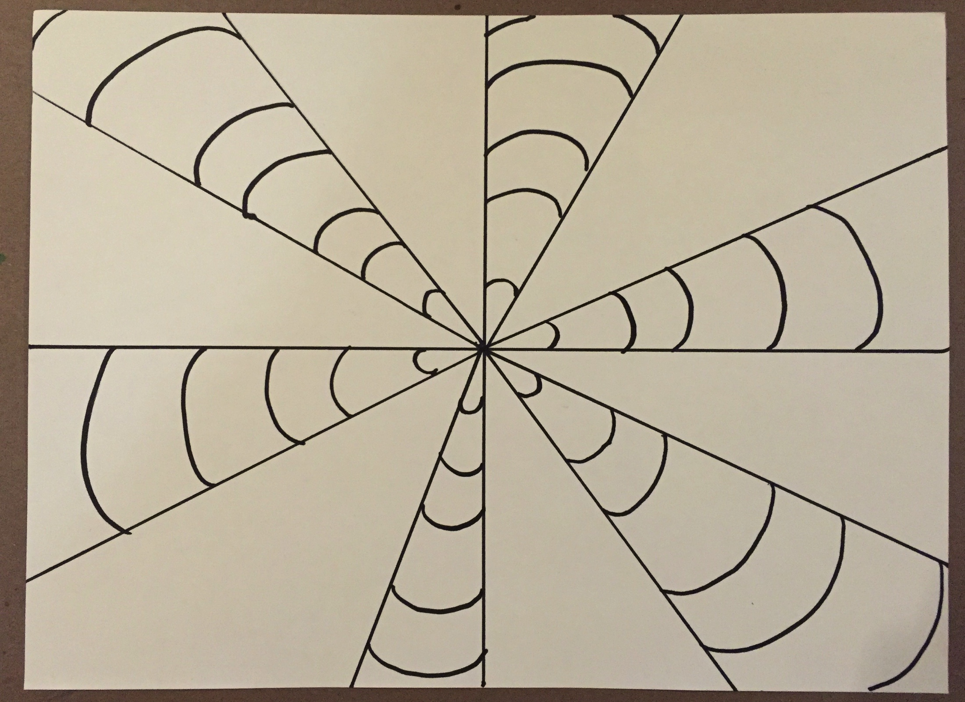
Step 3 – Draw “smiley face” lines on every other triangle to create stripes.

Slide 16
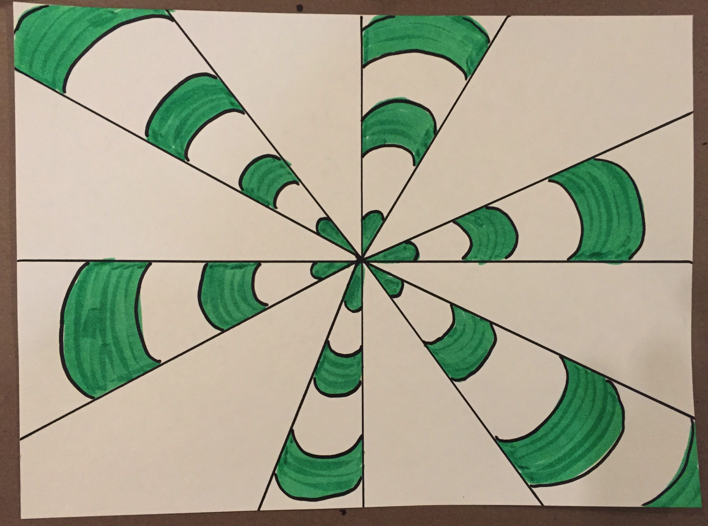
Step 4 – Color in those sections with one color.

Slide 17
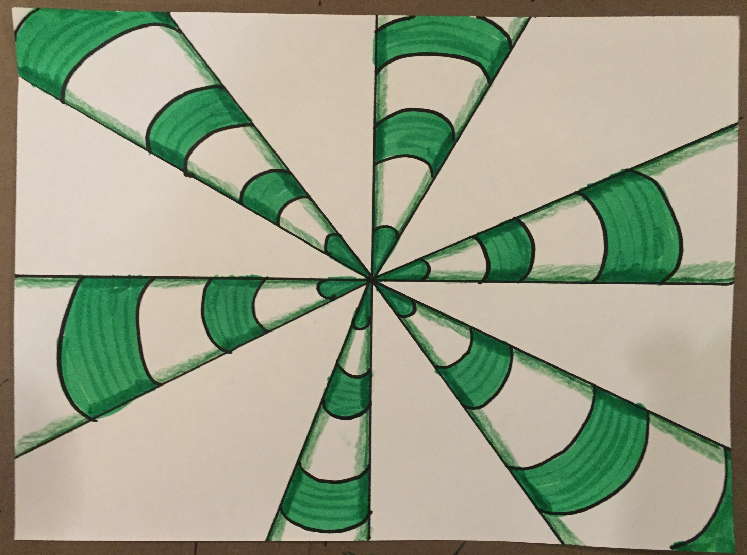
Step 5 – Create a 3-dimensional look by shading with your colored pencil on the sides of the white areas and with a darker layer of your markers on the sides of the colored areas.

Slide 18
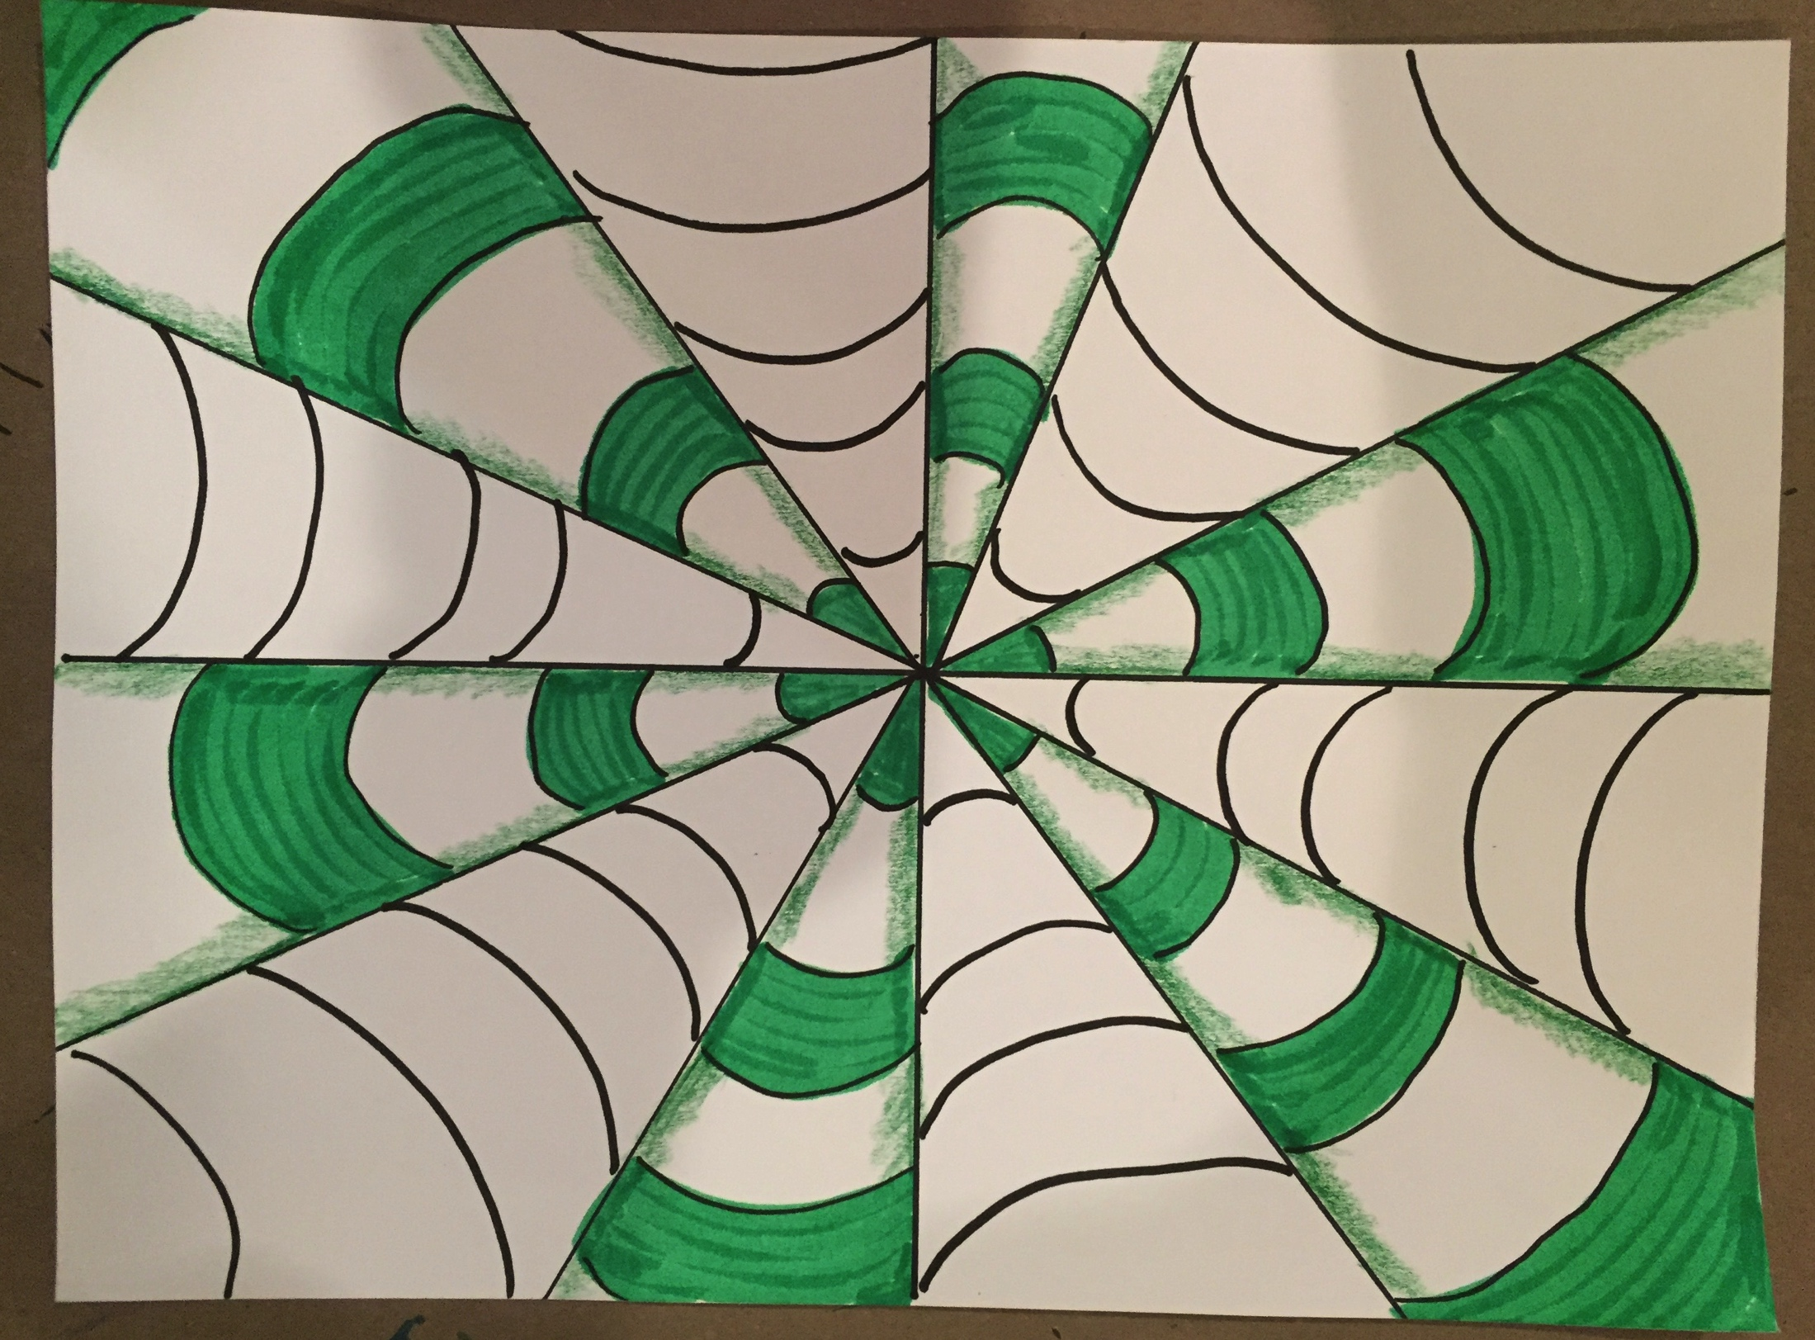
Step 6 – Draw “sad face” smiles on the other cones so the lines are still curved but are in the opposite direction of the first six cones.

Slide 19
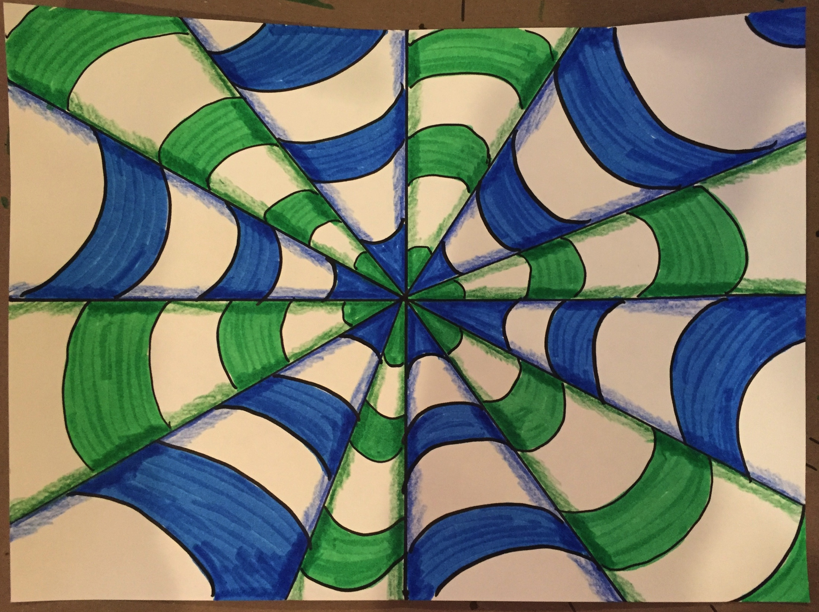
Step 7 – fill in the stripes on the cones with a different color and then shade as you did before.

Slide 20
Step 8 - Glue the cut out photo on your drawing.

